Slide 1

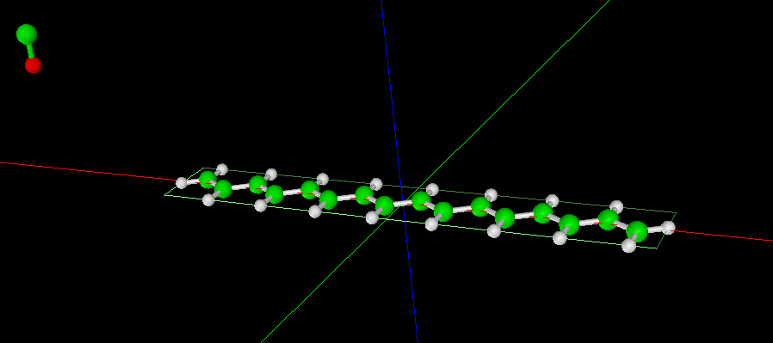
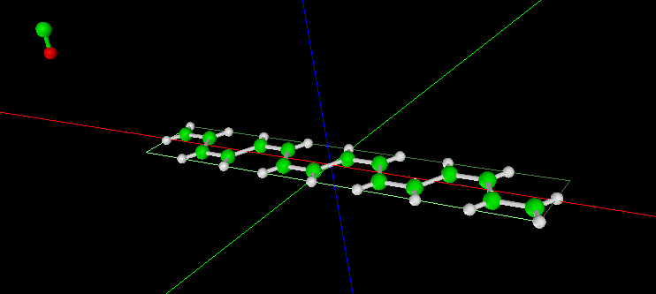
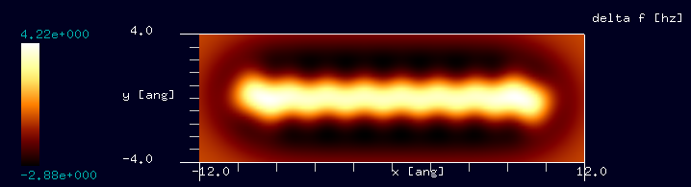
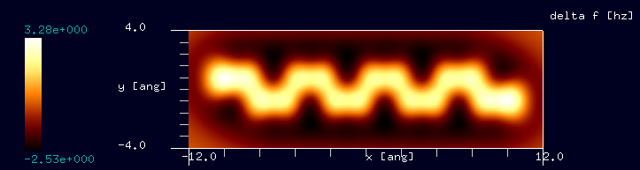
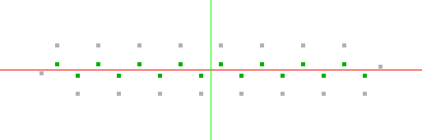
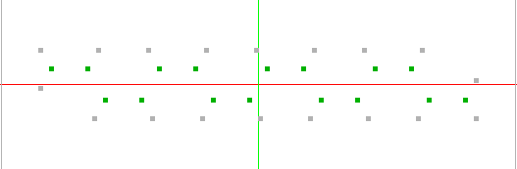
【CG】ポリアセチレン分子の周波数シフトAFM像
trans-polyacetylene (C16)
cis-polyacetylene (C16)
(We assumed the same C-C bond lengths for both model.)
Tip: CO molecule
Tip: CO molecule
Sample: trans-polyacetylene (C16)
Fixed in space.
Sample: cis-polyacetylene (C16)
Fixed in space.
Setup configurations
Simulated frequency shift AFM image
Notes:
CG_FreqShift_Polymer_001a
CG_FreqShift_Polymer_001b

